Slide 1


CO5-AT3-Techniqual Presentation MLA0408-DEEP LEARNING Stochastic Encoders, Decoders and Contractive Encoders
Guided By
Dr.D.Sudhagar
Presented by :
T. Narasimha Reddy(192425190)

Slide 2
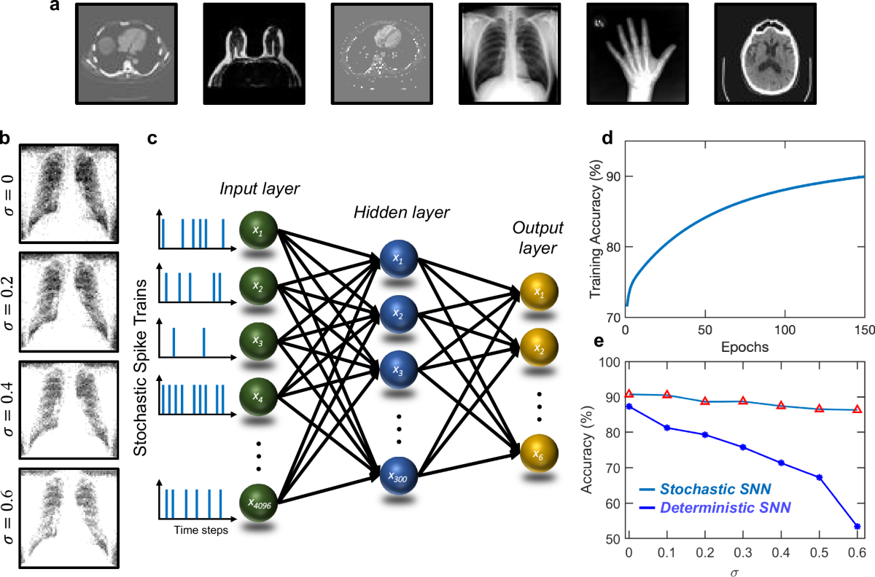
INTRODUCTION
Autoencoders are neural networks that learn efficient representations of data through encoding and reconstruction.
A standard autoencoder consists of an encoder, latent representation, and decoder.
Conventional autoencoders mainly focus on minimizing reconstruction error and may not handle uncertainty or input variations effectively.
Stochastic and Contractive Encoders extend the basic architecture to improve flexibility, robustness, and representation quality.
Stochastic models focus on probabilistic representations and data generation, while contractive models focus on stability and robustness.

Slide 3
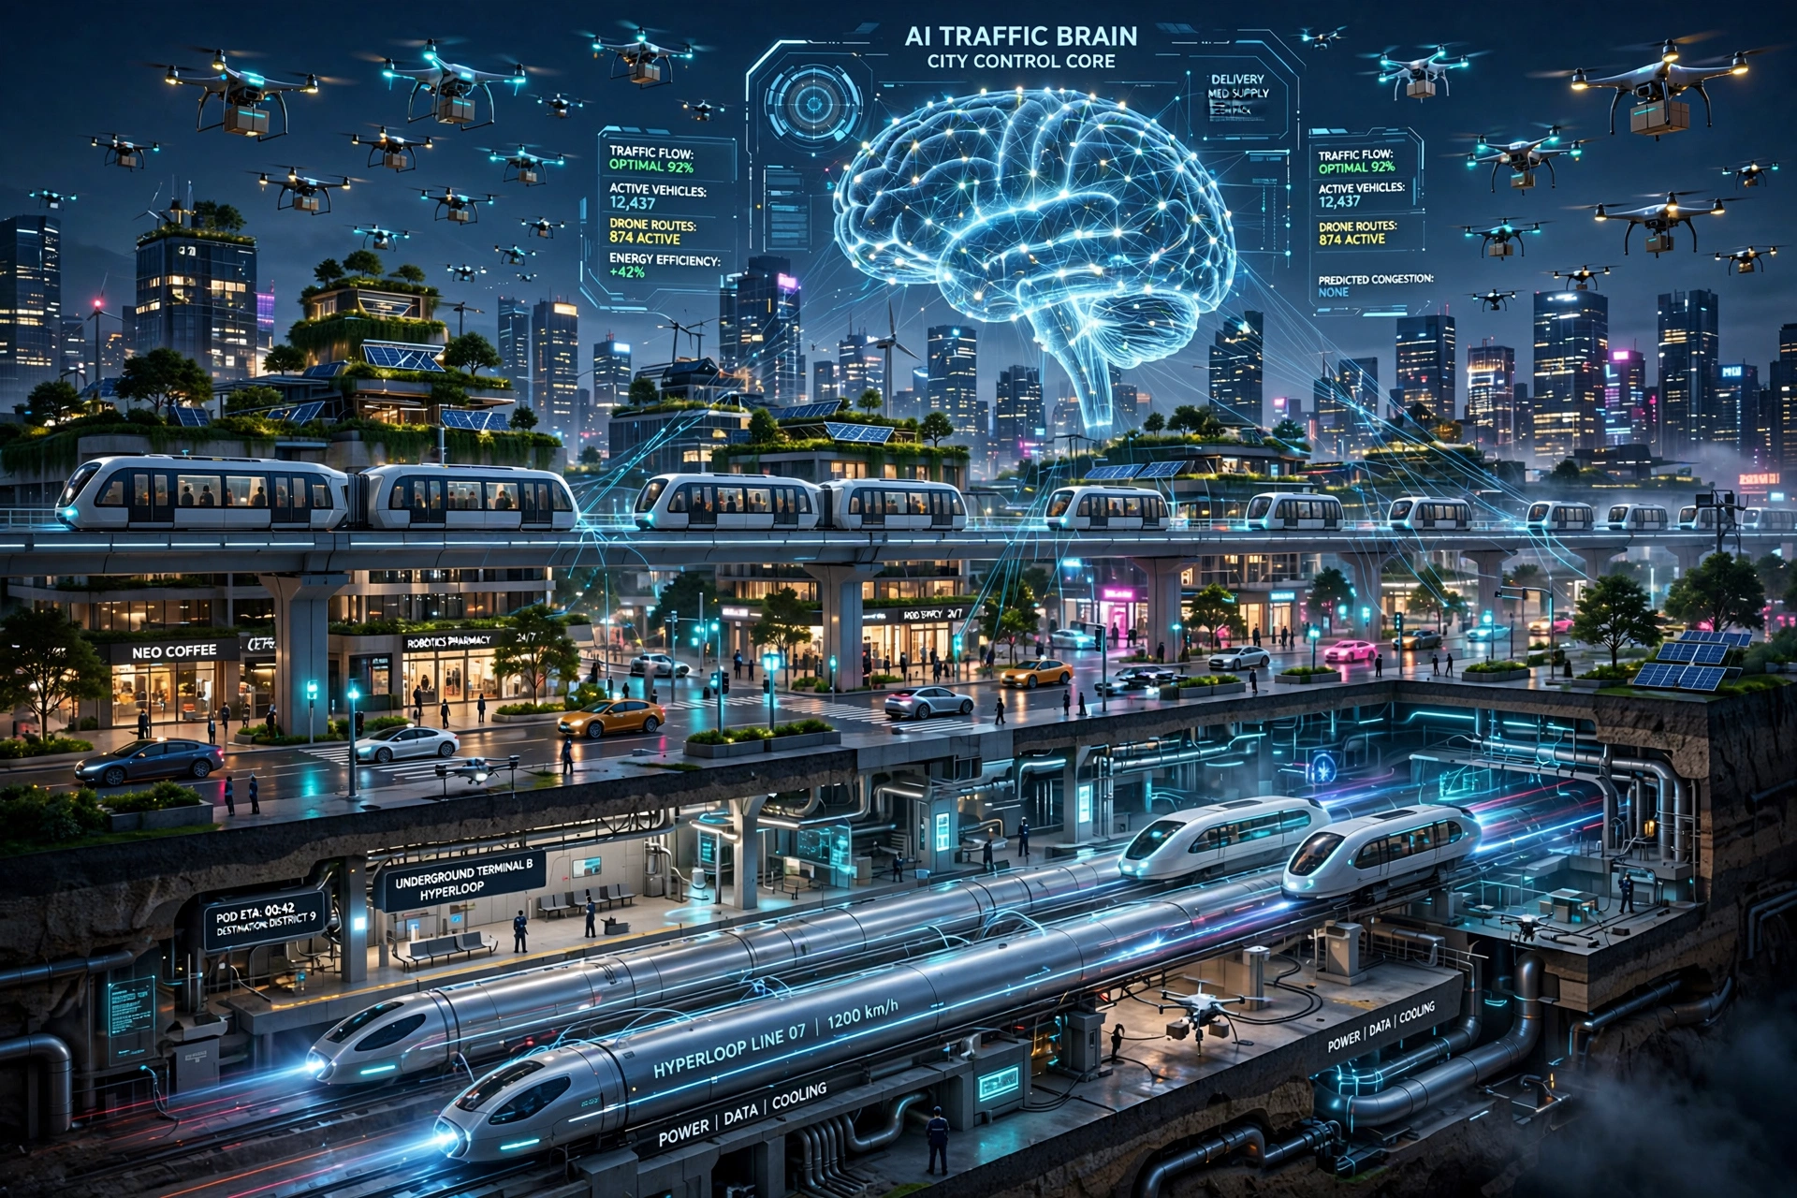
STOCHASTIC ENCODERS AND DECODERS
A stochastic encoder represents an input as a probability distribution rather than a single deterministic latent vector.
The encoder generally learns the mean and variance of the latent distribution for a given input.
A latent vector is randomly sampled from this learned distribution during the encoding process.
The stochastic decoder uses the sampled latent representation to reconstruct the input or generate a new data sample.

Slide 4
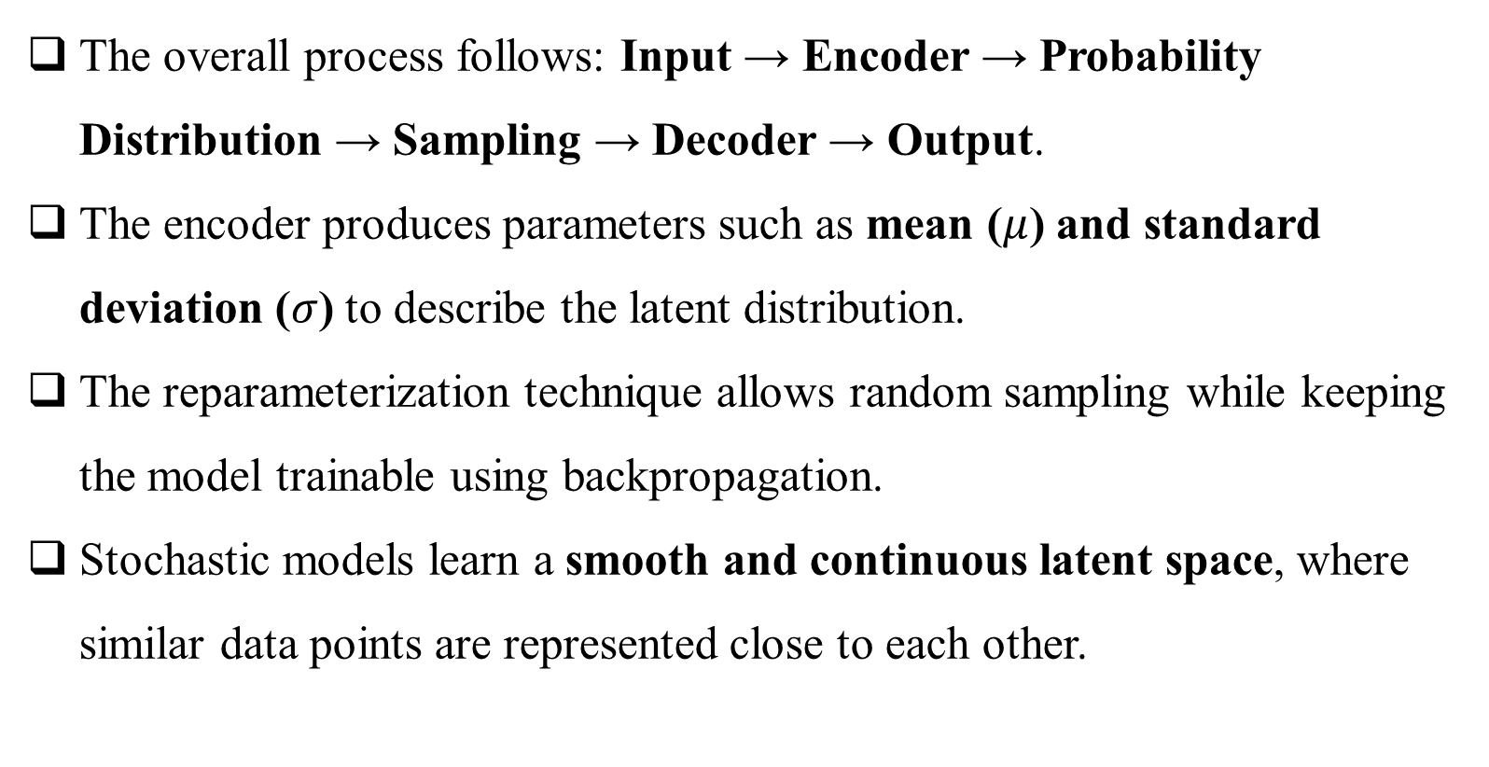
WORKING PRINCIPLE AND OBJECTIVES

Slide 5
COMPARATIVE ANALYSIS OF STANDARD, STOCHASTIC AND CONTRACTIVE AUTOENCODERS
Feature | Standard AE | Stochastic AE | Contractive AE
Representation | Fixed vector | Probability distribution | Stable vector
Encoder | Deterministic | Probabilistic | Deterministic
Sampling | No | Yes | No
Main Focus | Reconstruction | Generation & uncertainty | Robustness
Loss | Reconstruction | Reconstruction + KL | Reconstruction + Penalty
Noise Handling | Moderate | Good | High
Latent Space | Basic | Smooth | Stable
Generation | Limited | Strong | Limited
Key Benefit | Simple & efficient | Generates new data | Robust features
Applications | Compression | Image generation | Image recognition

Slide 6
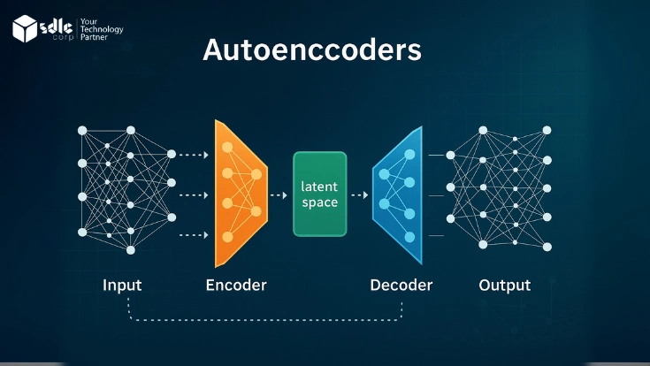
CONTRACTIVE ENCODERS
It adds an additional regularization term to the reconstruction loss to control the sensitivity of the encoder.
The contractive penalty is based on the Jacobian matrix, which measures how much the latent representation changes with respect to the input.
The model encourages small input perturbations to produce only small changes in the learned representation.
This results in stable, robust, and locally invariant features

Slide 7
REAL-WORLD APPLICATIONS
Medical Image Generation: Creates realistic synthetic medical images for training and analysis.
Image Recognition: Extracts robust features for accurate object and face recognition.
Anomaly Detection: Identifies unusual patterns or abnormal data in complex datasets.
Data Augmentation: Generates additional samples to improve machine-learning model performance.
Fault Detection: Detects abnormal behavior and potential failures in industrial systems.
Speech Processing: Learns useful representations for speech generation and audio analysis.

Slide 8
CONCLUSION
Stochastic Autoencoders effectively model uncertainty and generate diverse data samples.
Contractive Autoencoders learn stable and robust representations against small input changes.
Both approaches provide important improvements over standard autoencoders.
Their applications include image generation, recognition, anomaly detection, and data augmentation.
The choice of architecture depends on whether the main goal is reconstruction, generation, or robustness.

Slide 9


